Slide 1
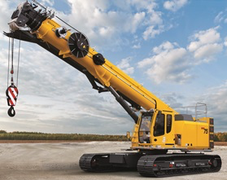
BIG CRANES INDIA PVT. LTD.
Infrastructure revolution in India

Slide 2
Overview of Infrastructure Industry in India.
IMMEDIATE FUTURE OF CONSTRUCTION EQUIPMENT USING SECTORS
Infrastructure sector is one of the key drivers for Indian economy. The sector is highly responsible for propelling India’s overall growth.
World class infrastructure in India is the Goal of present Government - Road Transport, Highways, Shipping and Aviation being the prime segments of focus. Investments to the tune of Rs. 25 trillion budgeted over the period of next three years.
A major part of this is allocated for developing 27 industrial clusters and for road, railway and port connectivity projects.

Slide 3
Overview of Infrastructure Industry in India Contd…
In the Year 2007 Sale of construction equipment in India was estimated to grow at a CAGR of 6.18% in volume till FY 2018.
Where as industry has witnessed growth of over 40% in FY 2016 compared to the previous year. The reasons can be attributed to the change in the governance at the center and a positive outlook of the Government towards this industry.

Slide 4
A Birds View of Opportunities Available
There is a huge demand for equipments in the aforesaid developmental plan.
Equipments such as CRANES, PILING RIGS, EXCAVATORS, DUMPERS AND GENERATORS play a major role from concept to commissioning of each project.
These equipments are mostly sourced by the industry through hiring. Most often this task of sourcing is either cumbersome or unreliable – High Risk.
Project timeline is largely dependent on the sourcing of these equipments and their availability when there are limited resources.
Right Equipment at the Right Time and a Reliable Service Provider is what Industry has always been craving for.

Slide 5
Introduction to TEAM BIGCRANES
A hand picked amalgamated team is in the lead which comprises of professionals with extraordinary industrial experience, visionary leaders and young Engineers with vigour to excell.
TEAM BIGCRANES DNA
-- Knowledge
- Enthusiasm
- Dedication.
We come with an Experience of providing Equipments to various industries for over 25 Years which gives us the know how and hence a sense of responsibility to make things better for the country. This has driven us to envisage this digital platform of BIGCRANES under the umbrella of Digital India Drive.

Slide 6
STRUCTURE
Our Website will have the following categories each having their own sub-categories:
CRANES – Plant & Machinery Erection to total completion of Project
PILING RIGS – Piling & Foundation
EXCAVATORS – Site Leveling
DUMPERS – Site Leveling
GENERATORS – for power of all above.

Slide 7
HOW IT WORKS
Log on to www.bigcranesindia.com
Chose your service required
Chose the customer or service provider
Register yourself
Check availability
Chose the product or service
Book and log out
Rest assured.

Slide 8



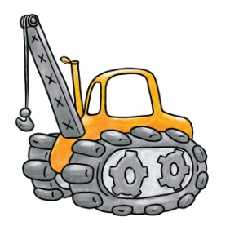






I WANT TO SUPPLY/SELL
ENTER YOUR EQUIPMENT DETAILS
LOG ON to www.bigcranesindia.com
UPLOAD EQUIPMENT IMAGES
ENTER YOUR EQUIPMENT LOCATION
GIVE OFFER

Slide 9
I WANT TO HIRE/BUY
LOG ON to www.bigcranesindia.com
SUBMIT YOUR REQUIREMENT
SHORTLIST FROM AVAILABILITY
SUBMIT YOUR LOCATION
GET YOUR QUOTE

Slide 10
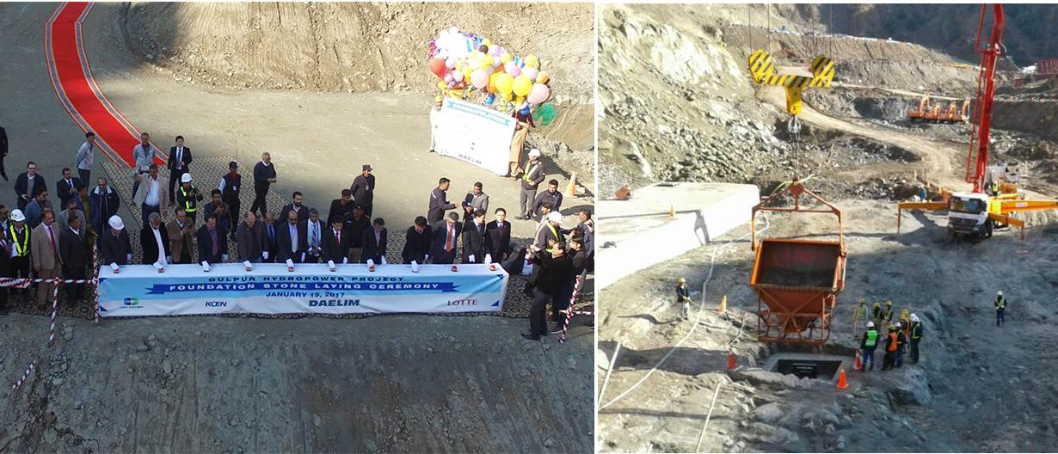
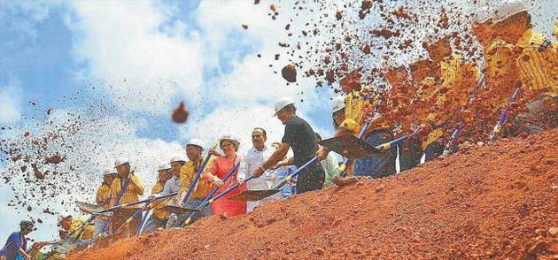
GROUND BREAKING
HOW IT HELPS
Our work starts from the date of Ground Breaking Ceremony

Slide 11
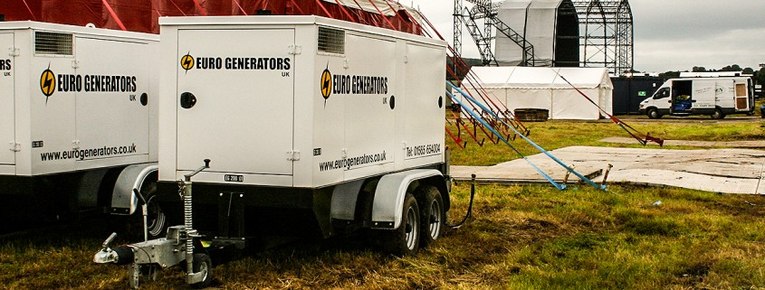
SITE LIGHTNING
HOW IT HELPS
We have equipped with different type of Generators and lighting systems from the day of ground breaking till the end of the project.

Slide 12
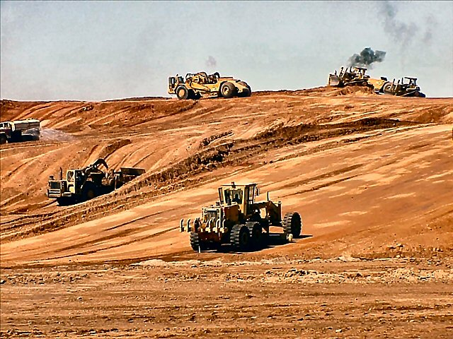
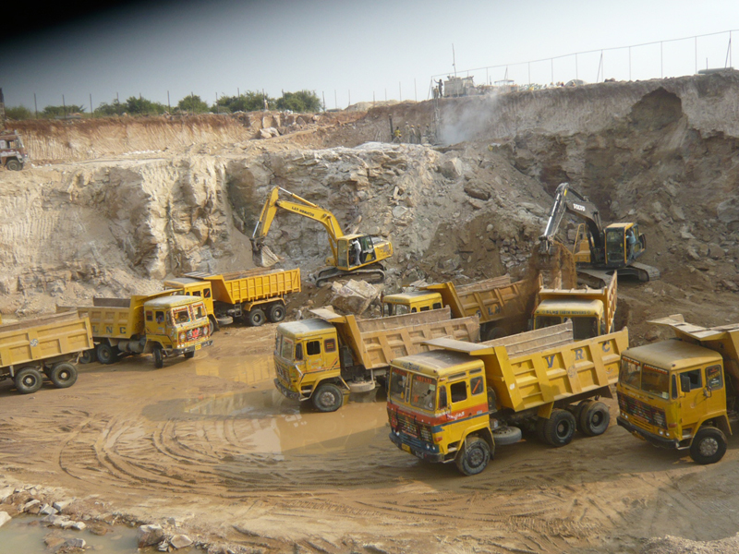
SITE LEVELLING & GRADING
HOW IT HELPS
We have with us Excavators, Proclainers, Backhoe Loaders & Dumpers for Site Leveling & Grading works and for all other earth related works.

Slide 13
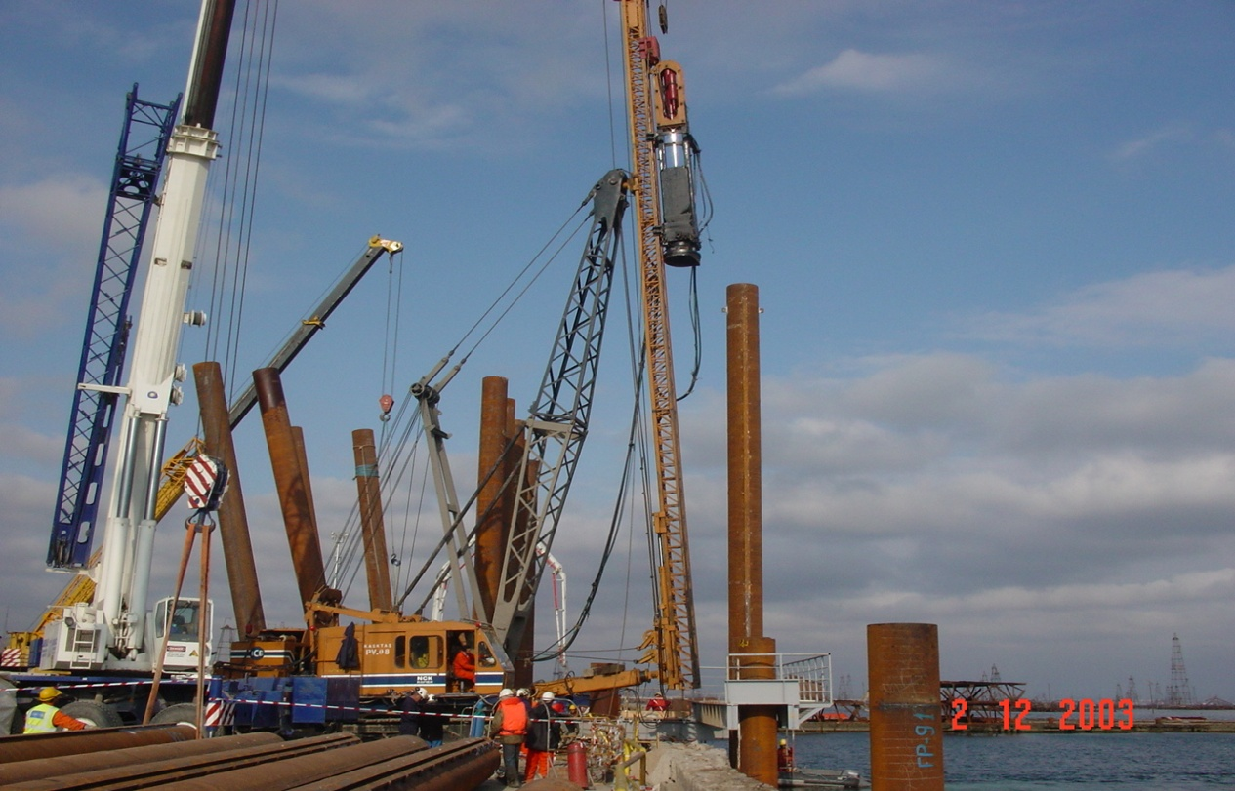
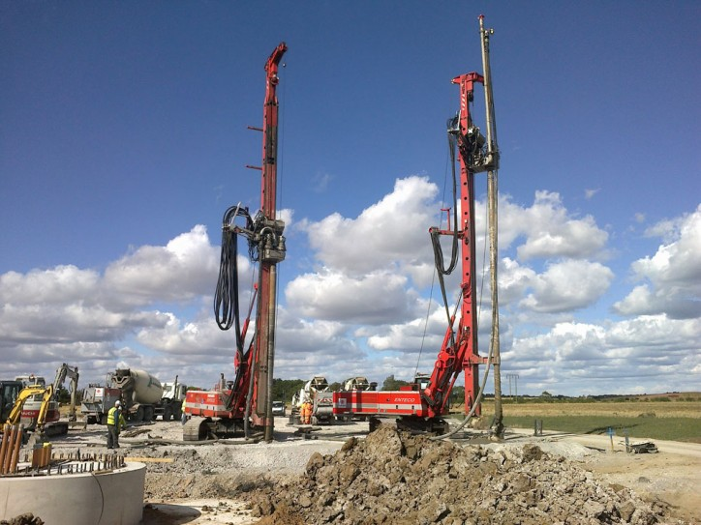
PILING & FOUNDATION
HOW IT HELPS
We have all types and categories of Piling Rigs for Piling and Diaphragm Walls

Slide 14

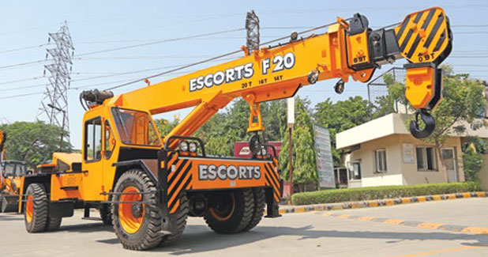
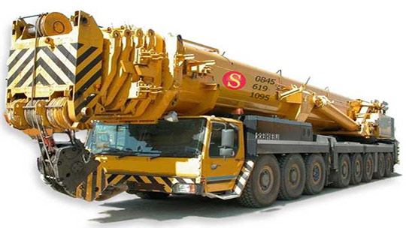
PLANT & MACHINERY FOR ERECTION
HOW IT HELPS
Soon after Piling, the erection of the plant starts with mobilization of different kinds of Cranes, Forklifts, Man-Lifts, Hydra’s, etc., which are available plenty all around the site which saves your time and money.

Slide 15
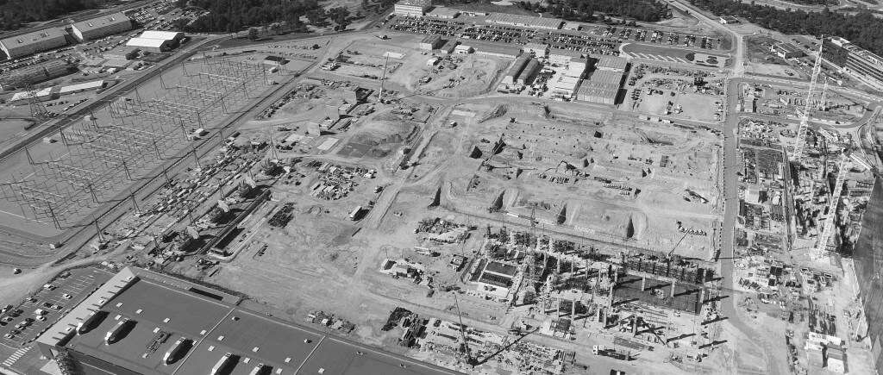
FROM START OF THE PROJECT
HOW IT HELPS
After plant erection with these cranes, the only activity left is Commercial Production that’s where we sign off.

Slide 16

TILL COMMERCIAL PRODUCTION

Slide 17

A PEEK IN TO OUR WEBSITE UNDER CONSTRUCTION

Slide 18
OUR MISSION
Contributing to the businesses of our clientile and the welfare of the society by providing adequate information to all and creating a congenial platorm for all to grow safer and richer.
Our social innovation includes using digital technology in skill development among the youth. Sharing and tackling issues of safety of operating personnel, business owners and their equipments by providing a friendly interactive training time to time.

Slide 19
POTENTIAL
BCI assumes a large equipment population in India at present which will keep BCI busy for over five years. Besides there will be growth of over 25% within the next five years in the equipment volume parallel to the growth in infrastructure industry as envisaged by Government of India

Slide 20
FUTURE OF BIG CRANES
Training of Operating Manpower suitable to each equipment and industry is another major business which can branch out of BCI which can grow in to a fairly promising revenue model.
Quality certification of Equipments based on their age, condition and capacity is another service which will help end users rest assured and hence every service provider might like to employ. The requisite expertise, technology and manpower are already in place to give this business a shape.
JOB Portal specific to this infrastructure industry is yet another attractive arena where certified operators and service personnel can be hired from. This ensures quality of manpower and safer operation of equipments to the service providers.

Slide 21
REVENUE MODEL
BCI would charge a nominal Subscription fee for each equipment enlisted by a service provider and will ensure providing the details of address and equipment to the user who seeks the service based on the geographic location, capacity of the equipment/job, suitability. This promises regular enquiries to the service providers which they can convert in to business immediately and for future too.
BCI plans not to charge any service fee from the end user or the service provider for this service besides the subscription fee from service provider.

Slide 22
SWOT ANALYSIS

Slide 23
STRENGTH
This is a First of its kind business model in India encompassing all needs of Infrastructure Equipment Industry. The potential is immense and hence provides BCI a virgin and eager market to render its serivces. This area is yet not explored or ventured by any one on a professional scale and thus is available for harvesting immediately. BCI ensures every user to be safer than before in terms of credibility of service provider, equipment safety and availability of options.

Slide 24
WEAKNESS
Being a service industry, BCI will be vulnerable to manpower iteration. Best in Industry emoluments and incentives will help retention of employees, in which BCI will leave no stone unturned.

Slide 25
OPPORTUNITY
BCI looks forward to a steep organic growth in its core operation. However, this accumelated knowledge base, customer database and operation expertese will give way to new opportunities of revenue from Job Portals, Quality Certifications, Human Resource Development, Equipment sales, Advertisements of spares and consumables used for equipments etc..

Slide 26
THREAT
Like any startup industry, BCI will surely remain under threat of mushrooming competition soon after its venturing. Keeping abreast with the industries needs and establishing strong brand awareness and loyalty will help keep BCI ahead of others always.

Slide 27
BIGCRANES REVENUE SOURCE
MEMBERSHIPS FROM CORPORATE CUSTOMERS
SUBSCRIPTIONS FROM SERVICE PROVIDERS
REGISTRATION OF EQUIPMENTS ON SITE
CERTIFICATION OF EQUIPMENTS
TRAINING OF MANPOWER AND CERTIFICATION
ADVERTISEMENTS

Slide 28
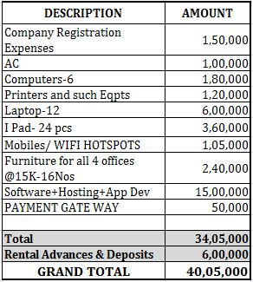
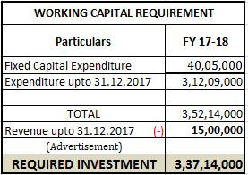
FUND REQUIREMENT

Slide 29
EXPENDITURE SUMMARY
S.No | ACTIVITY | TOTAL
1 | RENTALS | 20,42,000
2 | STAFF SALARIES | 1,51,41,000
2.1 | TRAVELLING EXPENSE | 89,40,000
 | DIRECOTORS& OTHERS TRAVELLING | 28,50,000
3 | BUSINESS PROMOTIONS
 | WEB MAINTANACE | 3,30,000
 | EMAIL ADVERTISING | 5,50,000
 | SMS ADVERTISING | 5,50,000
 | GOOGLE OPTIMIZATION | 30,00,000
 | CONFERENCES/ MERCHANTIZING | 50,00,000
 | YOUTUBE ADVERTISING | 10,00,000
 | CALL CENTER EXP | 12,50,000
 | Sub total | 4,06,53,000
4 | FIXED CAPITAL EXPENCES | 40,05,000
 | GRAND TOTAL | 4,46,58,000

Slide 30
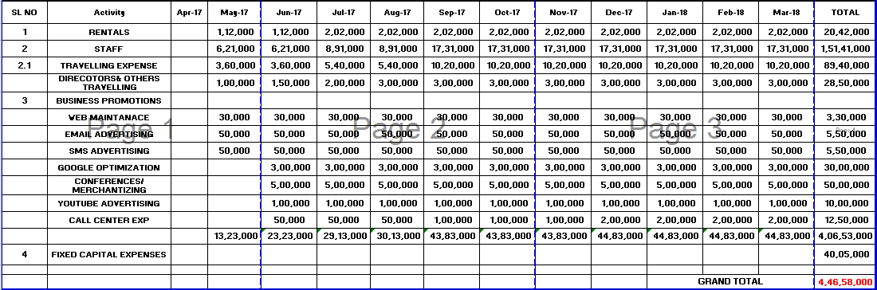
EXPENDITURE WORKOUTS

Slide 31
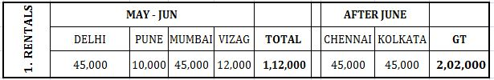
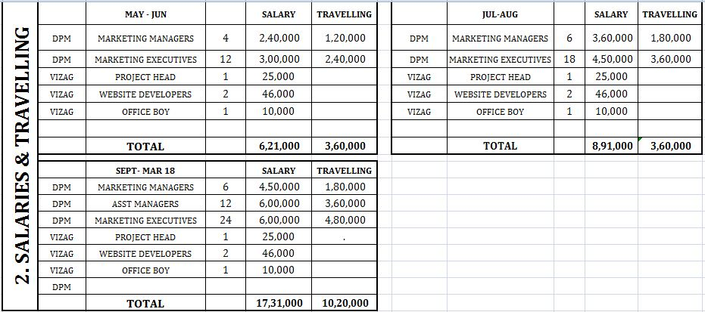
EXPENDITURE DETAILED WORKOUTS
20
28
46

Slide 32
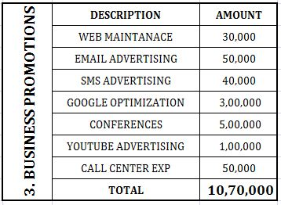
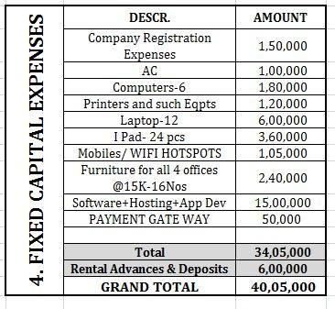
EXPENDITURE DETAILED WORKOUTS

Slide 33
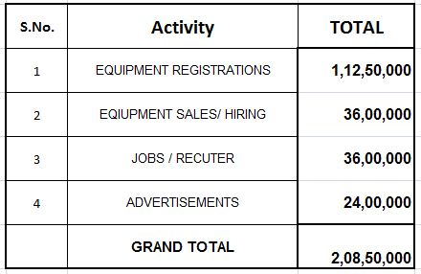
REVENUE SUMMARY

Slide 34
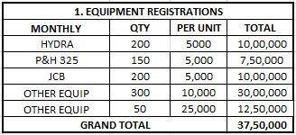
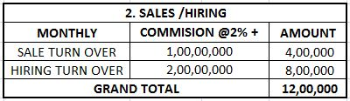
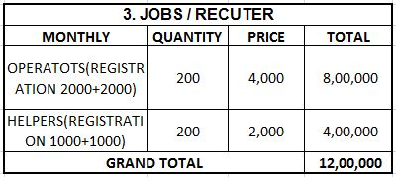

REVENUE DETAILED WORKOUTS

Slide 35
KEY FINANCIAL INDICATORS

Slide 36
TEAM BIGCRANES
THANK YOU

